Slide 1

nrega Analysis
01
Harsh Gotecha
Mentorness

Slide 2
Introduction
02
Welcome to the NREGA Data Analysis Dashboard. This interactive platform provides an in-depth exploration of the National Rural Employment Guarantee Act (NREGA), a pivotal initiative designed to ensure wage employment for rural households in India. My dashboard leverages a comprehensive dataset, encompassing metrics such as job cards issued, workforce participation, budget allocations, and project completion rates.
By utilizing advanced data analytics, this dashboard offers valuable insights into NREGA's implementation and its impact across various states and districts. Users can explore detailed visualizations and trends, facilitating a deeper understanding of how NREGA is contributing to rural development and economic empowerment in India.

Slide 3
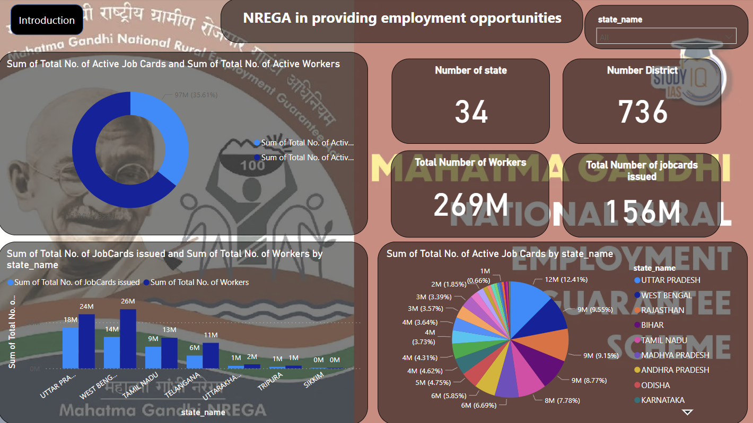
Harsh Gotecha
03

Slide 4
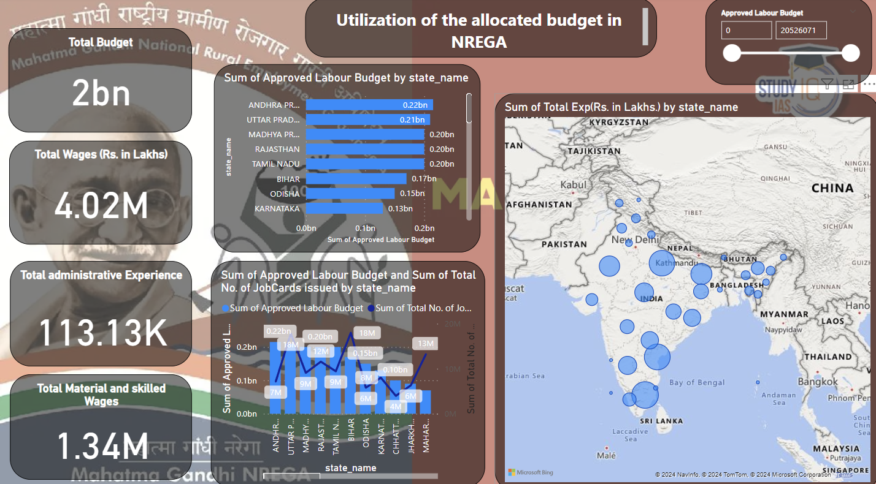
Harsh Gotecha
04

Slide 5
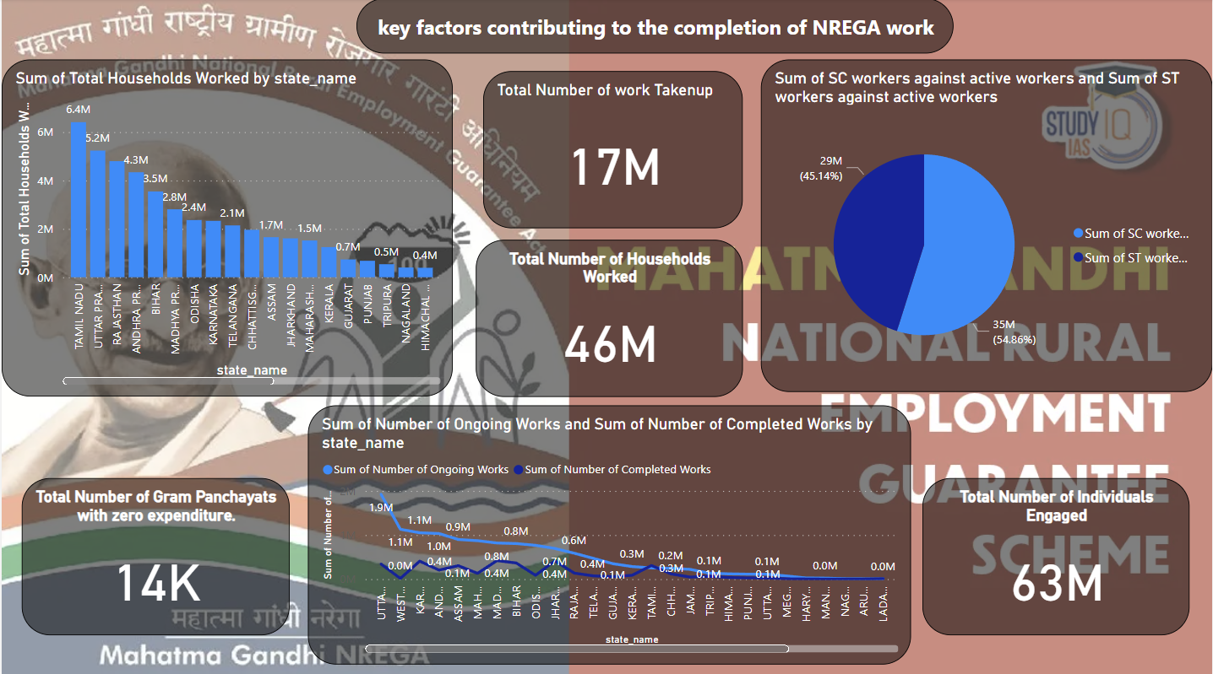
Harsh Gotecha
05

Slide 6
Harsh Gotecha
06
Thank you!

